Slide 1
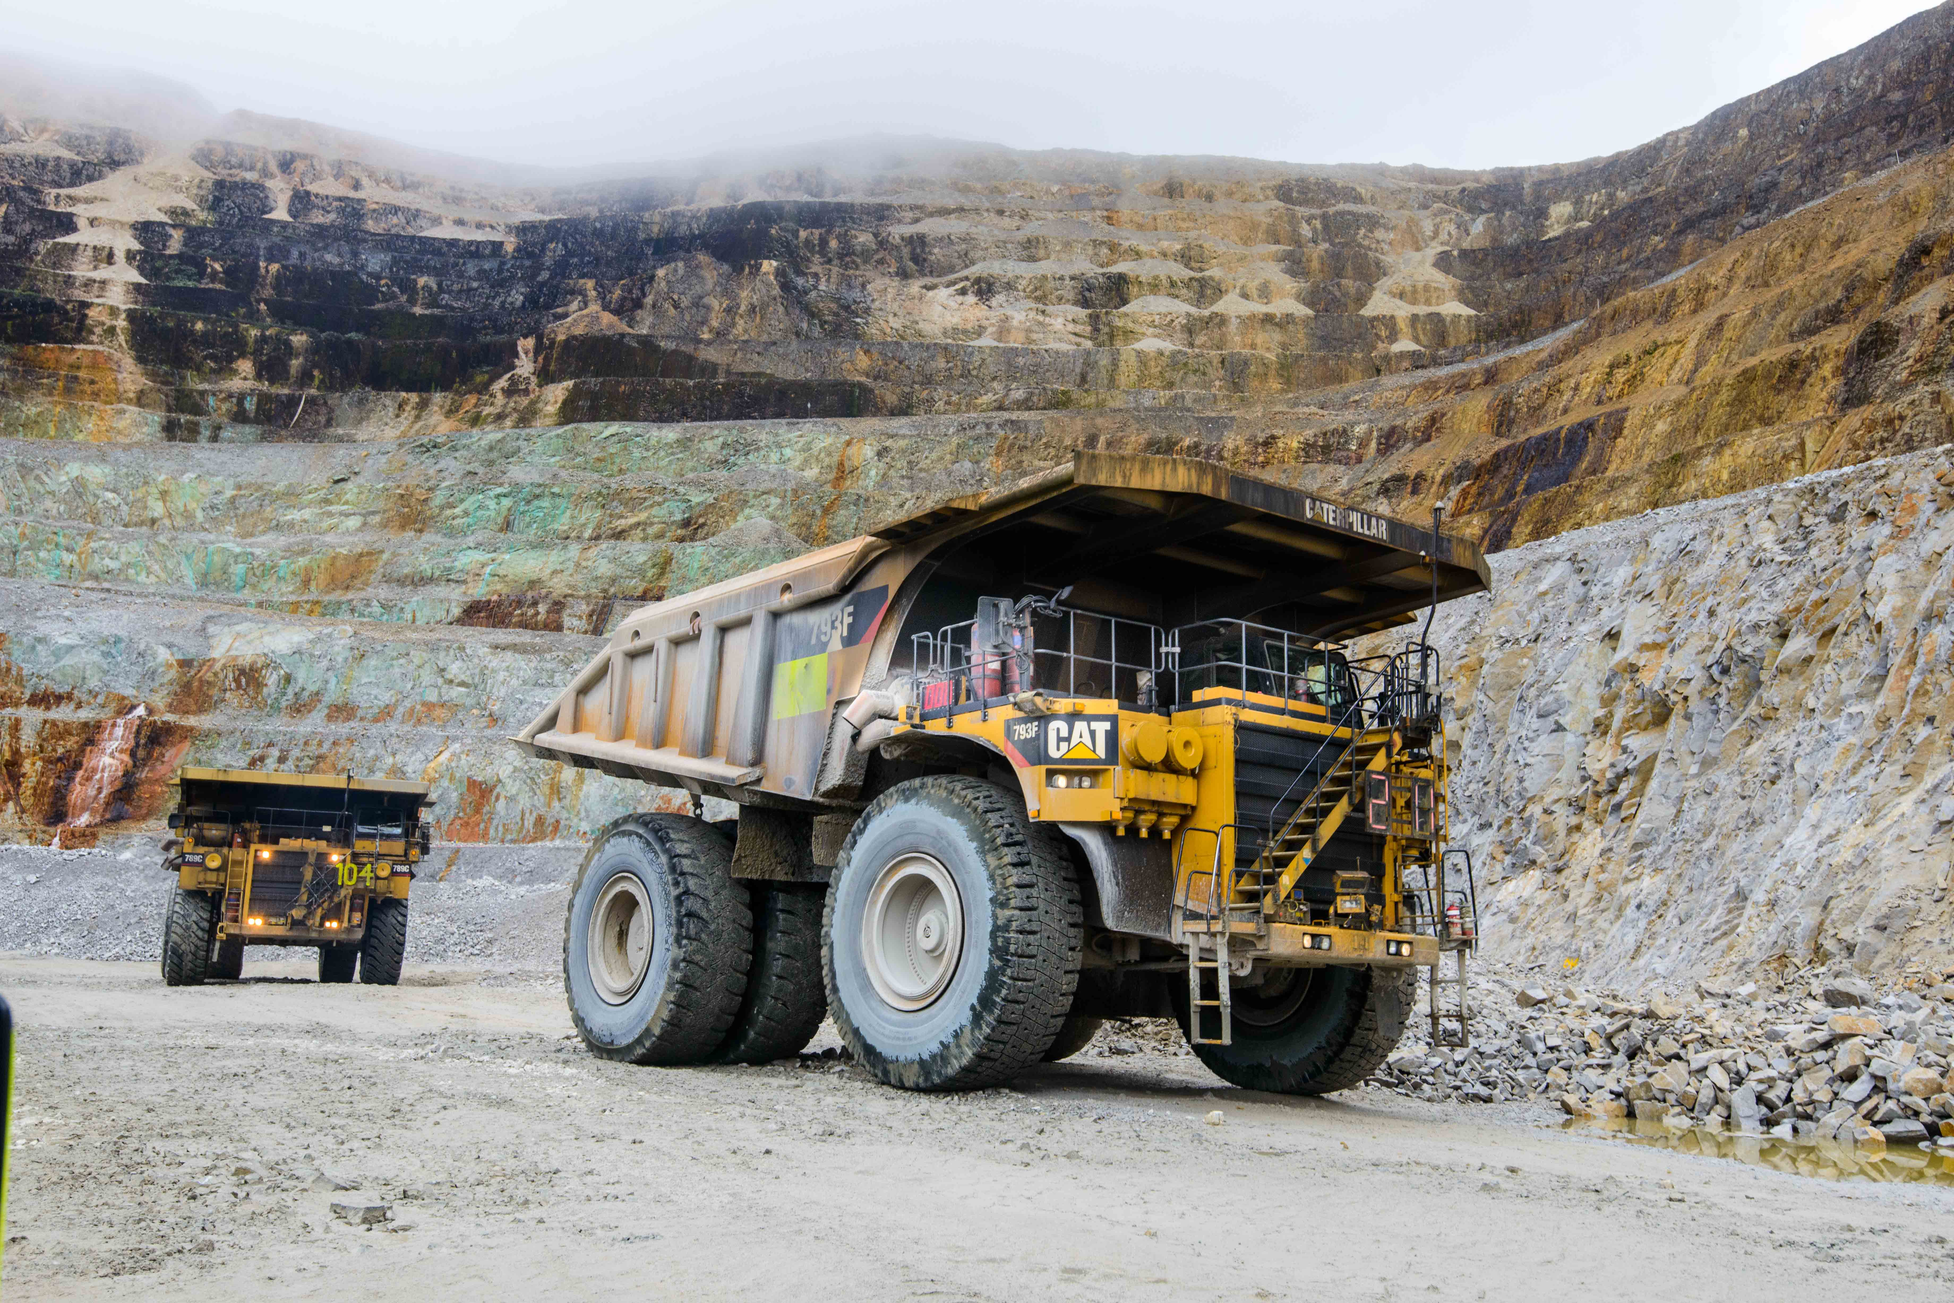
Operations Business Unit
Mining Ops. 2024 NMSW Program

Slide 2

Mine NMSW Weeks Activity Plan - 28th April – 03rd May 2024
Sun. 28th April | Mon. 29th April | Tue. 30th April | Wed. 1st May | Thu. 2nd May | Fri. 3rd May
Opening | Day 1 | Day 2 | Day 3 | Day 4 | Day 5 (Final)
MD & CEO opening message. Information package. Powerpoint. Infographic. | Prestart meetings. Topic 1. Fit for work – Fatigue Management. Fatigue assessment during PSI. | Prestart meetings. Topic 2. Frontline supervision – Role of managing key risk & controls | Prestart Meetings. Topic 3. Tyres & Rim Safety – Risk assessment – Tyre handling, deflating, change out process | Prestart Meetings. Topic 4. Service and Maintenance - QA/QC on LV and Mobile Equipment fleet | Prestart Meetings. Recap NMSW Topic. “Managing the critical controls of mobile equipment risks”
Mine Office to NY | Various Locations | Various Locations | Various Locations | Various Locations | Various Locations
Activities for the day; Screen MD’s Message Location set up at main offices & Crib Huts. Distribute awareness Posters and challanges. Set up games and rewards (participation). Ball/Dart Games during lunch/crib time (30 Mins) | Activities for the day; Safety quiz related to NMSW topic (PSI/Radio ch1. Rolled out one-on-one fatigue Rediwatch awareness. Dispatch to select outstanding radio calls on reporting equipment interactions & reward. | Activities for the day; MBU Leadership engagement (CCM/CRV) Collect equipment prestart for the day and assess quality & reward. Equipment cleanliness campaign. Traffic blitz/sport checks. Simulator challenge (VoC) | Activities for the day; Safety quiz related to NMSW topic (PSI/Radio ch1. Safety/Training Field Interaction. Leaders CCM/CRV at tyre shop. Ball/Dart Games during lunch/crib time (30 Mins) | Activities for the day; Dispatch nominate outstanding safety operating hours nominee. Leaders Review Maintenance QAQC process. Review reliability/SAP equipment management. Drill – Equipment interaction. TN1. | Activities for the day; Safety quiz related to NMSW topic (PSI/Radio ch1. Simulator Challenges. Equipment cleanliness campaign assess & reward outstanding. Equipment prestart checks review and reward quality, consistency and outstand operators. Ball/Dart Games during lunch/crib time (30 Mins)

